Slide 1



iFlair Web Technologies Pvt Ltd.
Pitch Deck
Telephone
US: +1-347-878-2931
DK: +45 36 98 05 05
www.iFlair.com

Slide 2


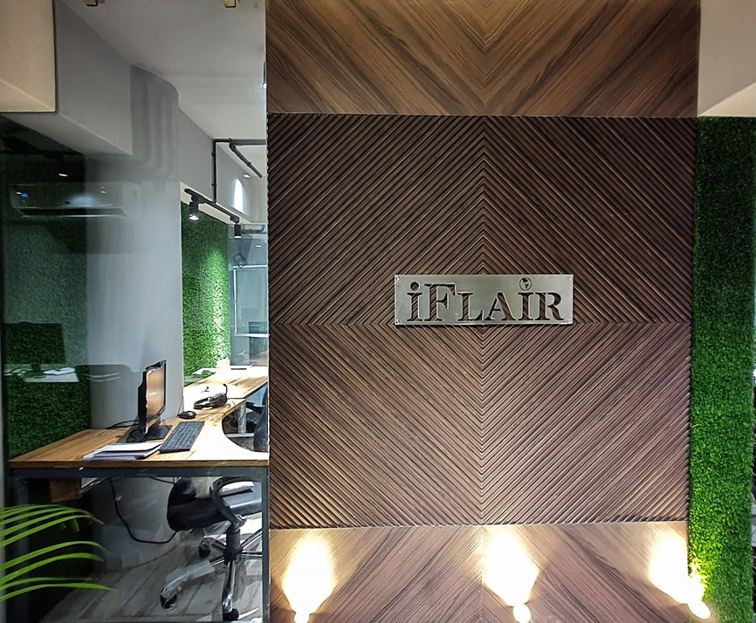


About Our Company
iFlair is an ISO 27001:2013 certified software development company serving clients from startups to Fortune 500. We provide offshore and onshore resources for Ecommerce, Enterprise Web, and Mobile development globally, delivering quality work on time. With deep industry expertise and a collaborative approach, iFlair focuses on innovation, scalability, and client-driven solutions at competitive rates. Their skilled developers aim to help clients achieve enhanced business value through continuous improvement.
ISO
3000+
38+
27001:2013
CERTIFIED
PROJECT DELIVERED
COUNTRIES
WE SERVE
250+
20+
1200+
www.iFlair.com
Employees
YEARS EXPERIENCE
Satisfied Clients

Slide 3

Our Company's Journey
Started Serving clients in Global technology market with focus in North America & Central Europe.
Achieved milestone of Serving 1000+ Clients and Digital Agency Owners globally.
Global Footprints
1000+ Clients
December
2007
January
2018
December
2004
November
2012
June
2023
Established
100+ Employees
250+ Employees
Started iFlair as a Company
in 2004 with serving in India
Expanded the team to over 100 members. Enhanced productivity & Effficiency.
Expanded team size to over 250 & continuously boosting our capabilities significantly.
www.iFlair.com

Slide 4


Company values
01
Together We Grow
02
Delivering Standard Quality
03
Efficient Work Process
It guides our success through collaborative efforts and principled values.
Committed to delivering standard quality with a focus on excellence in every step
Prioritizing efficiency in our work processes to maximize output and minimize waste.
04
Integrity
05
Respect Your Resources
06
Easy Work Process
Operating with integrity and transparency to build lasting trust and partnerships.
Responsibly utilizing the shared resources to maintain a trust in our collaboration.
Simplifying the work process to make your experience convenient and easy.
www.i﻿Flair.com

Slide 5
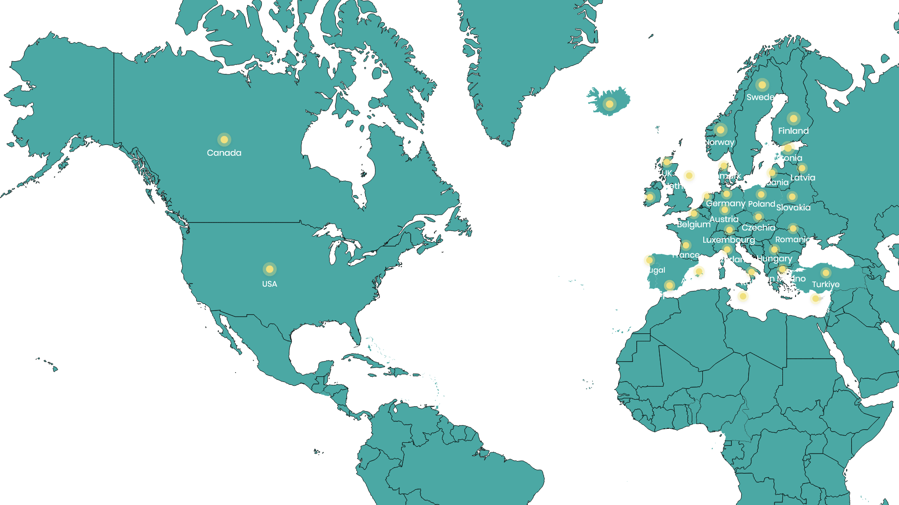

Global Footprints
Served clients across the globe from
38+
Countries

Slide 6



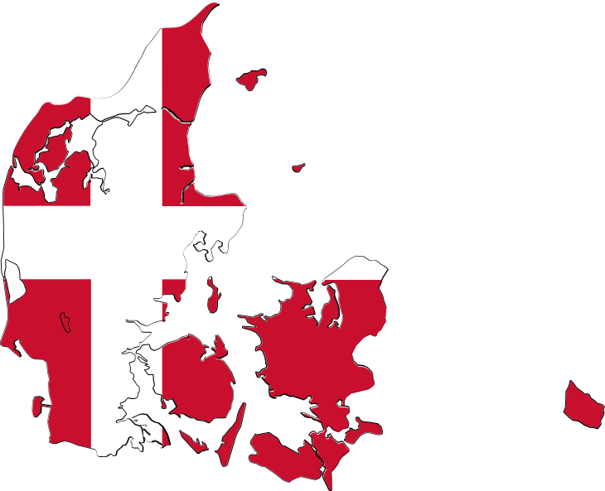
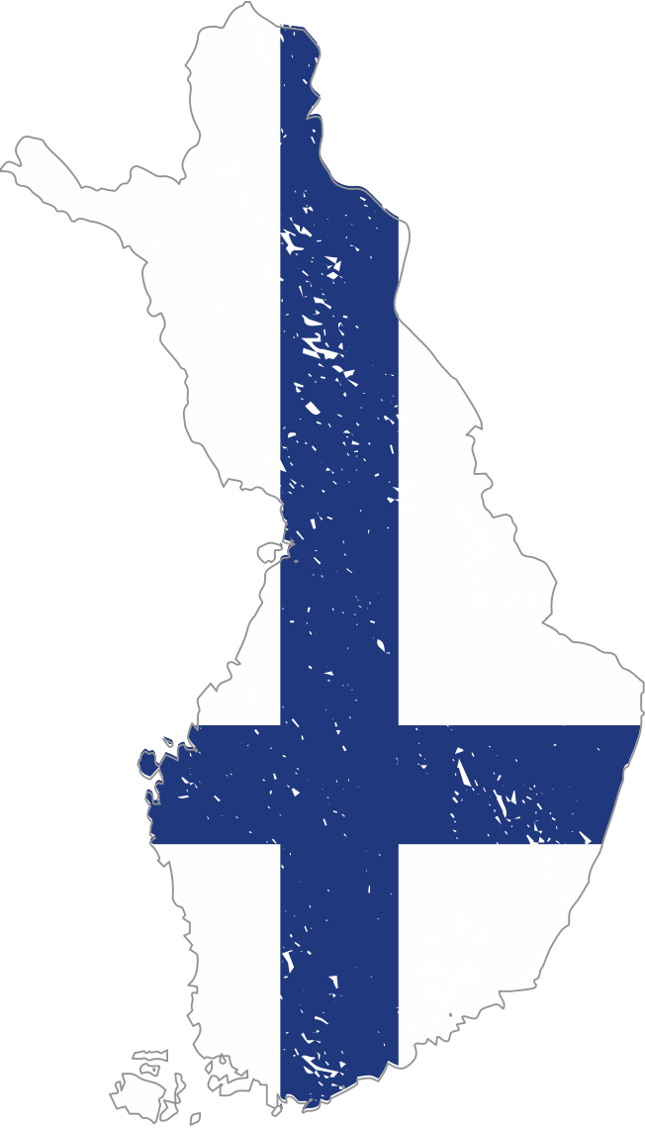


















Timings & Cultural Knowledge
  Real-time collaboration, no disruptions.
  Align hours with your schedules.
  Adaptive work shifts for Multiple time zones.
  Consistent, timely client communication.
  Navigating Cultural Influences in Projects
  Expertise in Multilingual Systems development
  Familiarity with Global Design standards & Technology trends
  Overcoming Regional Project Challenges

Slide 7

Industries We Serve
www.iFlair.com

Slide 8
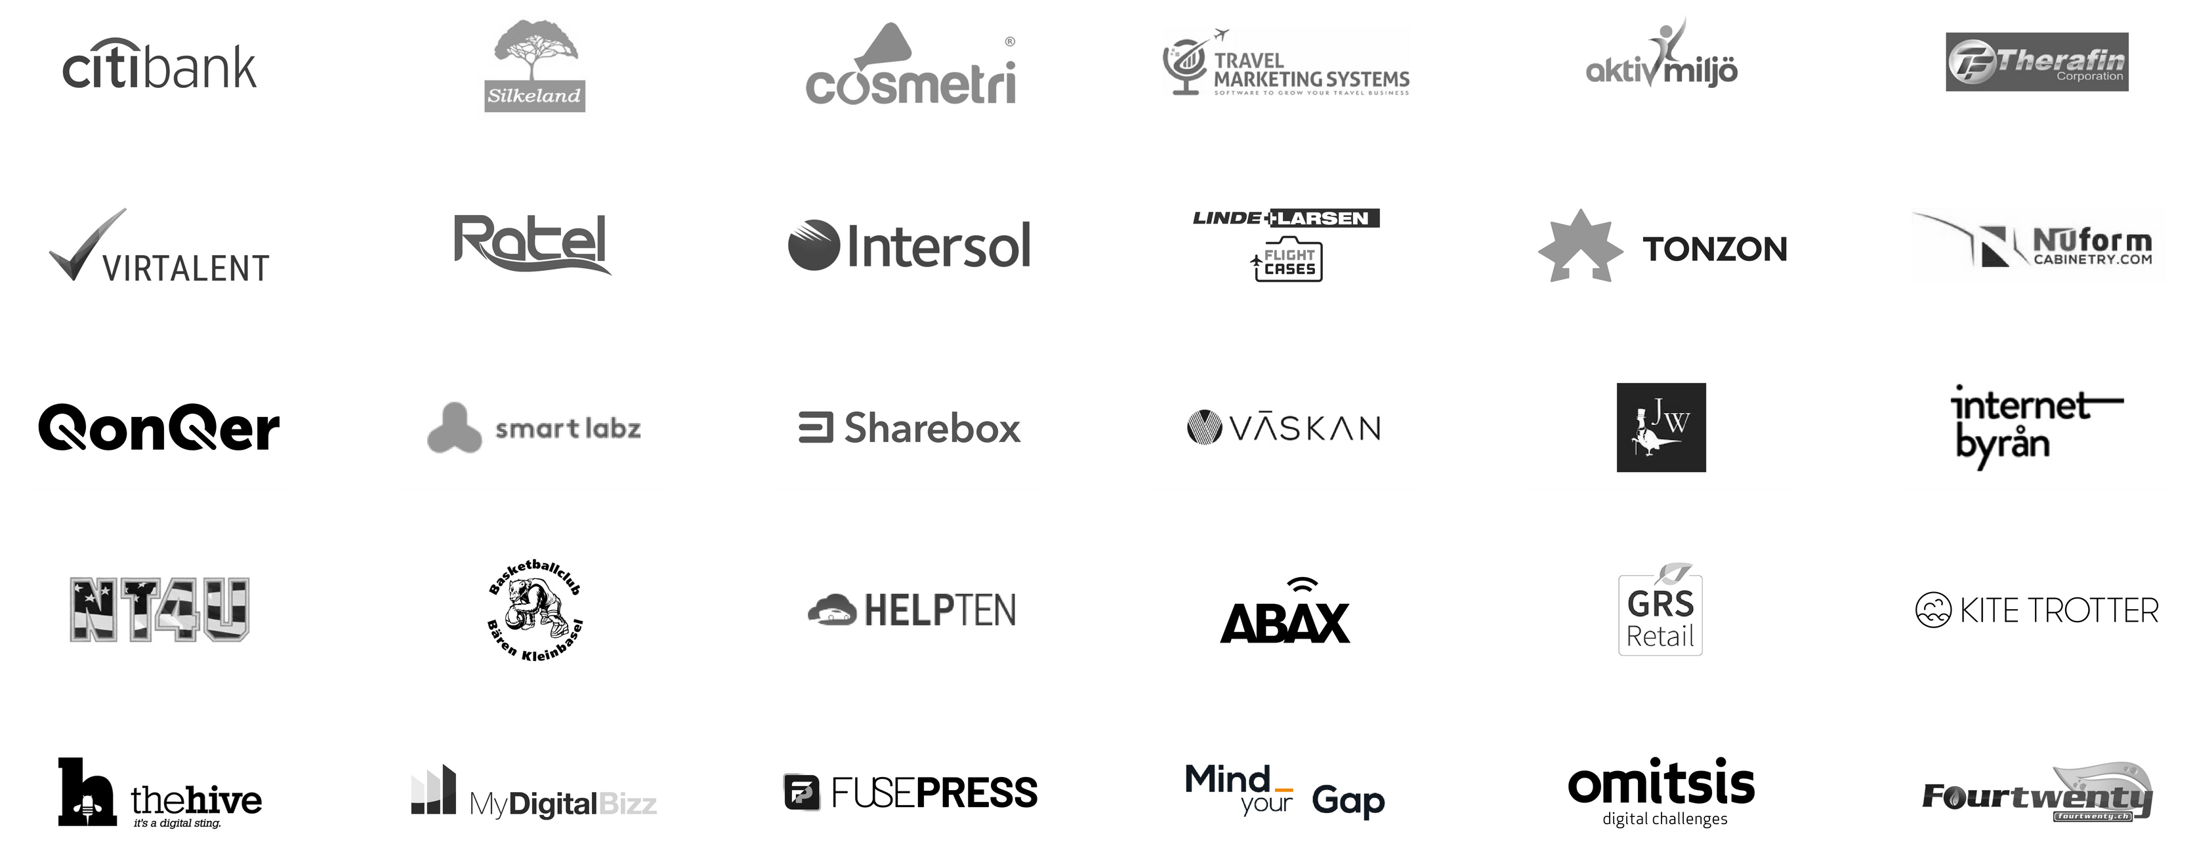
Our Clients
www.iFlair.com

Slide 9

Our Services
E-Commerce Development
Back-End Development
Front-End Development
www.iFlair.com

Slide 10

Our Services
CMS Development
Mobile Application
Cloud Services
www.iFlair.com

Slide 11

Our Services
Digital Marketing
Quality Assurance
www.iFlair.com

Slide 12
Our Fullstack Custom Development Services
Mean Stack
Mern Stack
Lamp Stack
Django Stack
www.iFlair.com

Slide 13
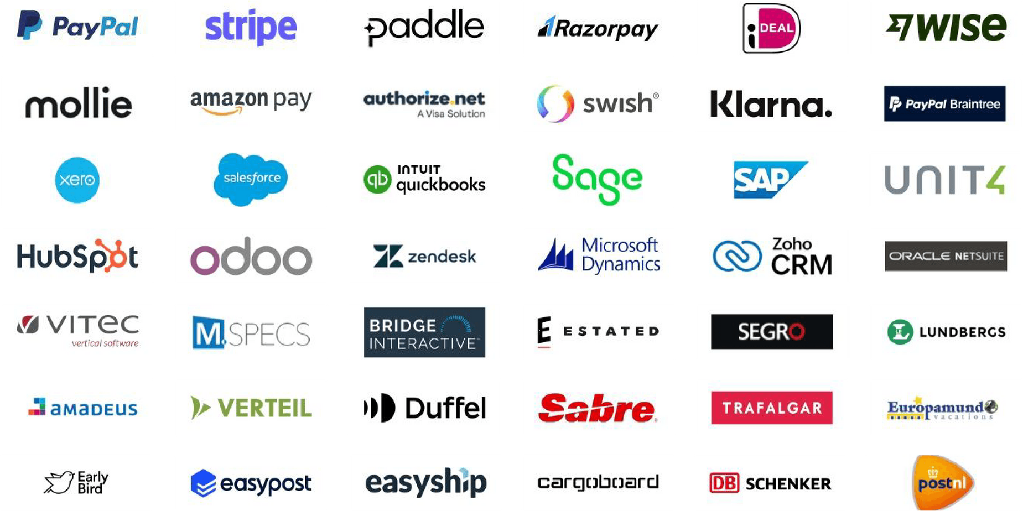
Top API Integrations
www.iFlair.com

Slide 14


Our Certifications
At iFlair, we take pride in our commitment to excellence and continuous improvement. We along with our team holds a range of industry-recognized certifications that underscore our expertise and dedication to delivering high-quality solutions
www.iFlair.com

Slide 15
Our Success Stories
Discover how we've partnered with global clients across diverse industries, leveraging over 20 years of expertise to deliver innovative solutions. Each case study showcases our commitment to excellence, from complex system integration to seamless website development. Explore our proven track record and see firsthand how we turn challenges into success stories.

Slide 16
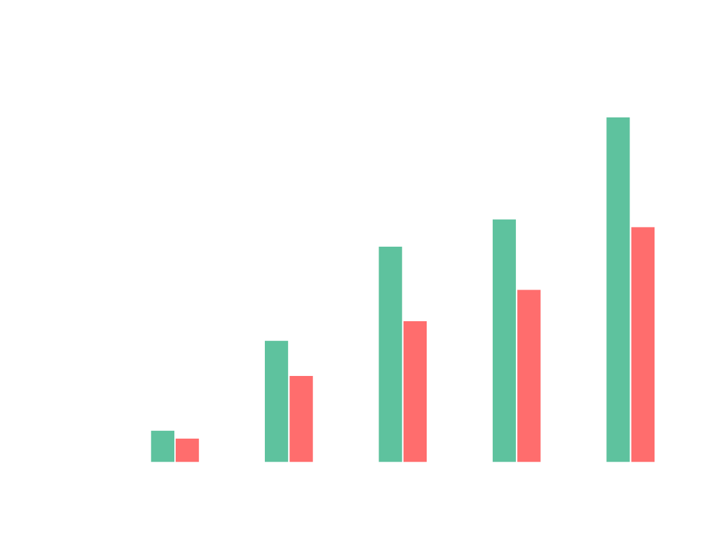
SWEDISH AGENCY’S 10X GROWTH REPORT
Our B2B agency has enabled continuous growth for clients across various industries through our website & Application development services. This journey showcases the impact of our services on different sectors, leading to the developmentof over 500+ websites and product-as-a-service platforms.
10X
As depicted in the graph, one of our partners, a digital agency in Sweden, began working with us in 2020. At that time, they handled an average of fifteen projects per year. After partnering with us, they were able to focus more on acquiring new clients and managing relationships, while relying on us for all their development needs. Currently, we are managing an average of 100+ projects per year together.
BUSINESS GROWTH
CMS SITES %
CUSTOMER SITE/PORTALS %

Slide 17

NUFORM CABINATERY YOY SALES
2X
Nuform Cabinatery has enabled continuous growth for their eCommerce store. This journey showcases the impact of our different services on on their growth , leading to 2X online sales through their webshop in a span of four years with 20%+ increase in annual growth.
1.15 Mn
1.04 Mn
870K
As shown in the graph, we Started working with Nuform Cabinatery 2021 and their sales was nearly 600K USD. Since then, we have continuously worked optimizing the user experience and minimizing checkout process through our CRO Strategy. We worked on analyzing the user behavior on the webshop and based on different matrices we worked on improvements which led 2X online sales in just Span of four years.
594K
TOTAL SALES IN USD

Slide 18
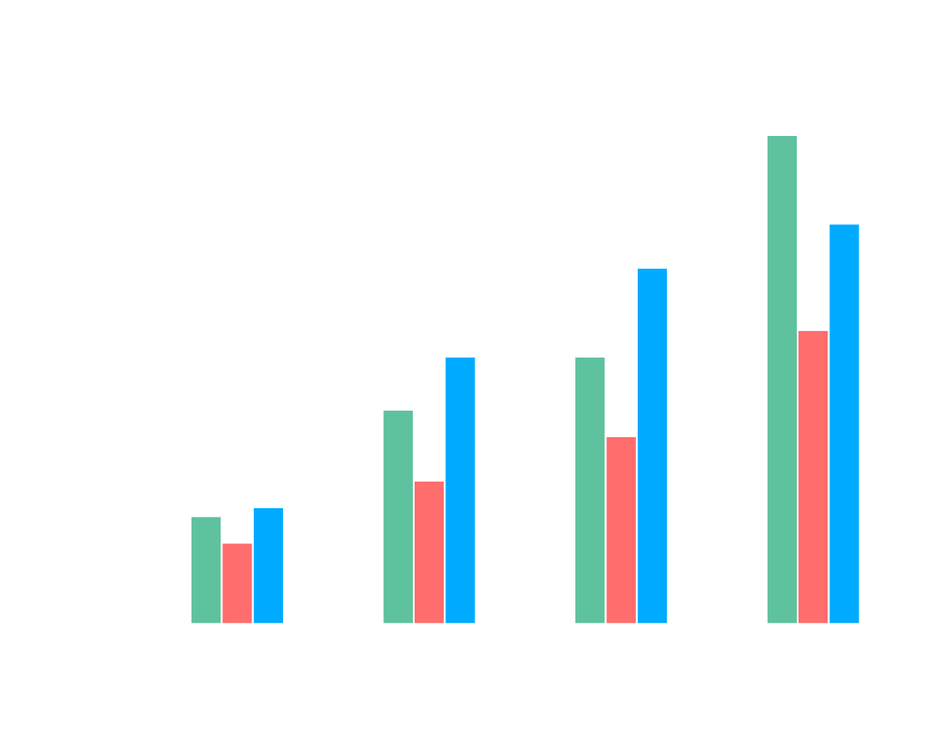
GRS RETAIL 4X GROWTH
More than 170+ Dutch and Belgian garden centres are the driving force behind GRS Retail BV, a company that is the market leader in terms of numbers and volume in the Benelux garden market in the field of purchasing, logistics, automation and sales.
4X
As shown in the graph, we launched the first version of the platform in 2020. Since then, we have continuously improved it based on customer feedback. The GRS team focused on acquiring new garden centers, while our team at iFlair worked diligently at the technical level to ensure a smooth customer experience. This approach helped retain customers, increase annual recurring revenue, and attract new clients through referrals.
BUSINESS GROWTH
QUALIFY LEADS
GARDEN CENTERS
EMAIL MARKETING

Slide 19
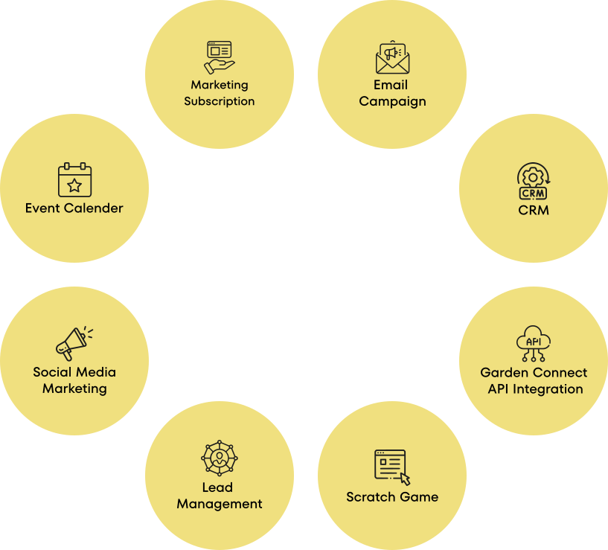

Laravel+
MySQL+
Tailwind+
Multi Domain+
GRS Retail BV
Our collaboration with GRS Retails BV, involved in developing a tailored SaaS solution for garden centers across Belgium and the Netherlands. This all-in-one platform integrates marketing automation tools for customizable email campaigns, event scheduling, and personalized subscription management. It includes innovative features such as digital scratch games to engage users, GDPR-compliant data management, and seamless CRM integration. Our solution enhances operational efficiency, boosts customer engagement, and provides actionable insights through detailed reporting, supporting GRS Retails BV in delivering personalized marketing strategies effortlessly.
Key Highlights
  170+ garden centers utilizing the platform
  2-year advance management of subscription plans
  Monthly activity calendar for subscribed services
  Automated personalized suggestions for marketing plans
Reference: https://www.grsretail.nl

Slide 20

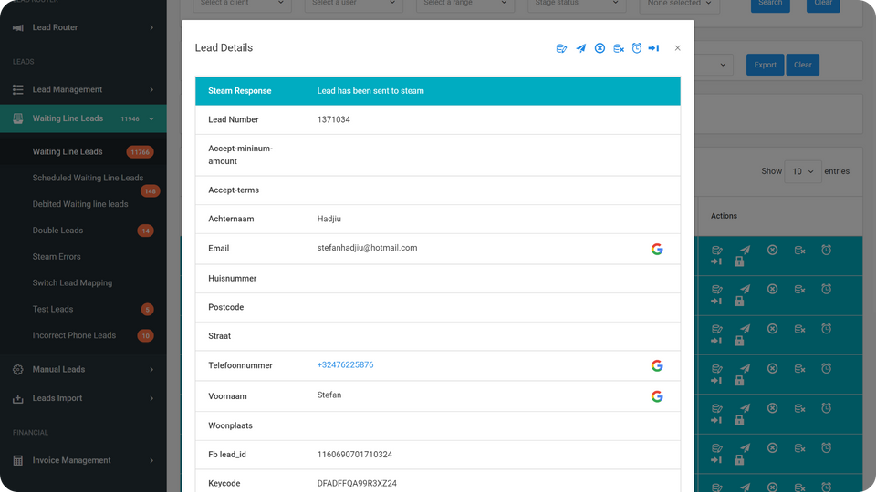
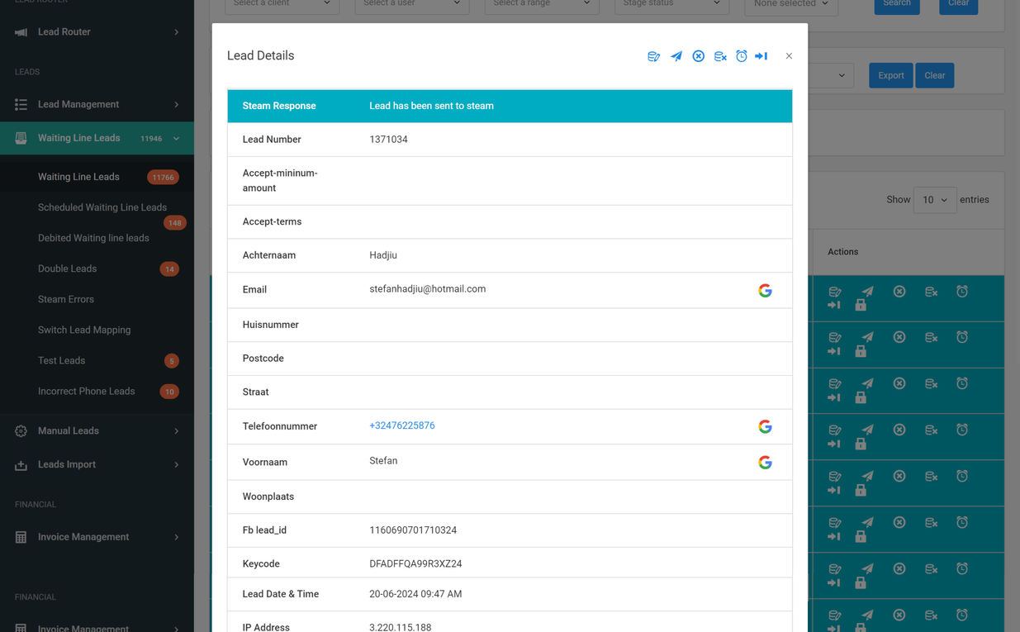
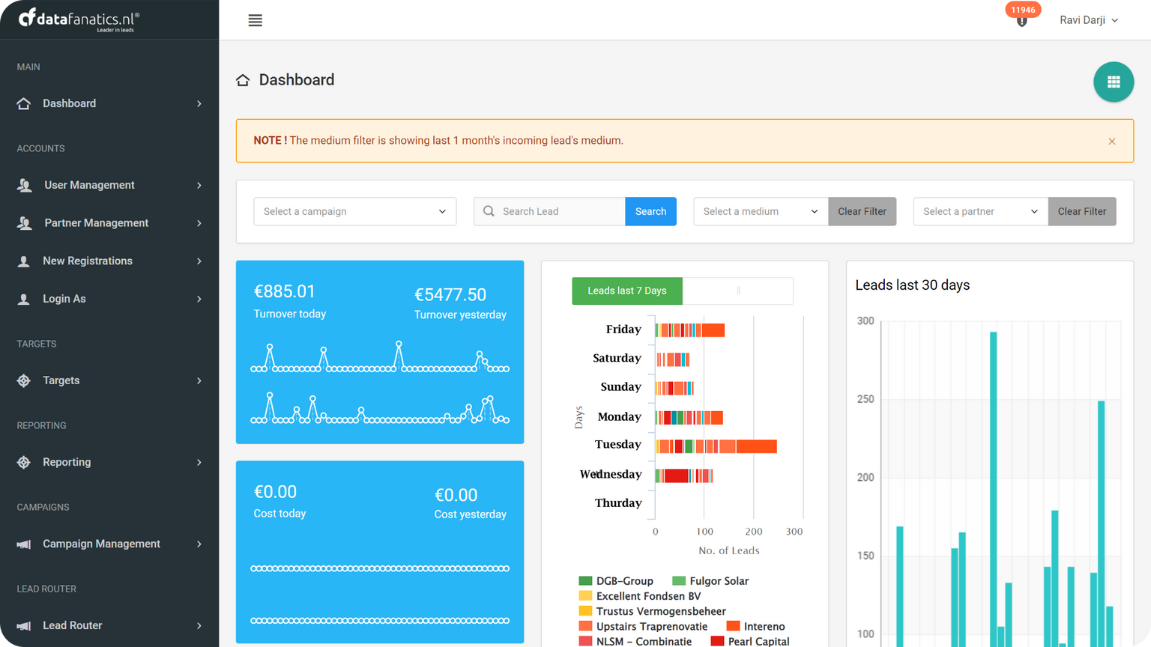
Laravel
MS SQL
Hub Spot CRM
Lead Portal: CRM
We developed Lead Portal, a SaaS solution for a company in the Netherlands, to enhance B2C lead generation and management. The platform collects leads from partners' websites, filters them for quality, and routes them to call centers. It integrates with CRM systems like HubSpot and automates workflows for efficiency. With features like campaign-wise lead reports, API integration, and invoicing based on approved leads.
Key Highlights
  Serving Mortgage brokers, solar panel, lotteries
  Daily leads processed: 30,000+
  Monthly verifications: 20,000+ calls/WhatsApp
  APIs for lead collection and CRM integration
  Lead filtering via cm.com and Steam APIs
  Comprehensive lead reports and invoicing
Reference: https://datafanatics.nl/

Slide 21

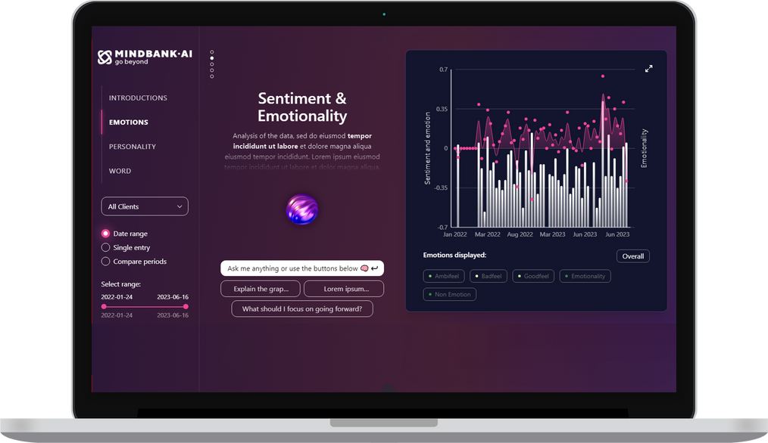
NextJS+
MongoDB+
Python+
Mindbank AI
iFlair has played a pivotal role in developing Mindbank AI, a sophisticated platform designed to advance organizational knowledge management and decision-making. Our team engineered a seamless user experience by integrating advanced artificial intelligence with a highly intuitive interface. We implemented sophisticated cognitive analysis tools that allow users to interact with their Digital Twin via voice commands or document uploads, ensuring a personalized and insightful experience.
Key Highlights
  Digital Twin who speaks 46+ Languages.
  Analytics engine for 26 emotions, 30 Personality traits.
  Integration with OpenAI
  AES256-CBC encryption
  Compliance with GDPR, HIPAA, CCPA, and CPRA standards.
Reference: https://www.mindbank.ai

Slide 22
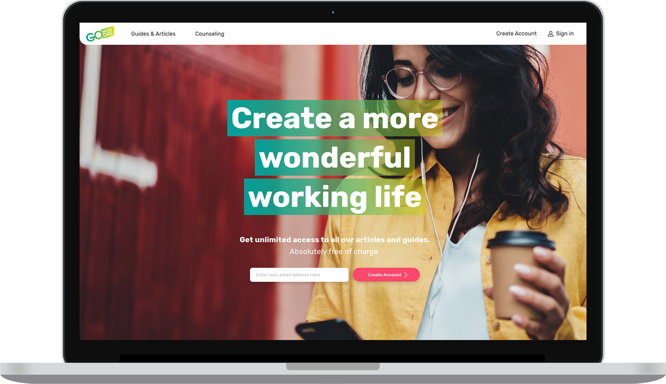
ReactJS +
Tailwind CSS +
GraphQL+
NodeJS+
MySQL+
Go Monday
Our work with Go Monday, a leading company in career & business consulting from sweden for creating a custom Career Counseling platform. This platform provides users with access to educational resources and expert advice tailored to their career needs. It includes a wide range of materials and consultancy services to help users with job searches, personal marketing, and business growth. The platform is designed to be user-friendly, making it easy to book consultations, manage appointments, and track progress, ensuring a smooth experience for those looking to advance their careers.
Key Highlights
  50+ certified counselors
  2500+ Users
  100+ guiding articles
  10000+ Counselling Sessions.
  35 services
  Operated digitally & open 365 days a year
Reference: https://www.gomonday.se

Slide 23
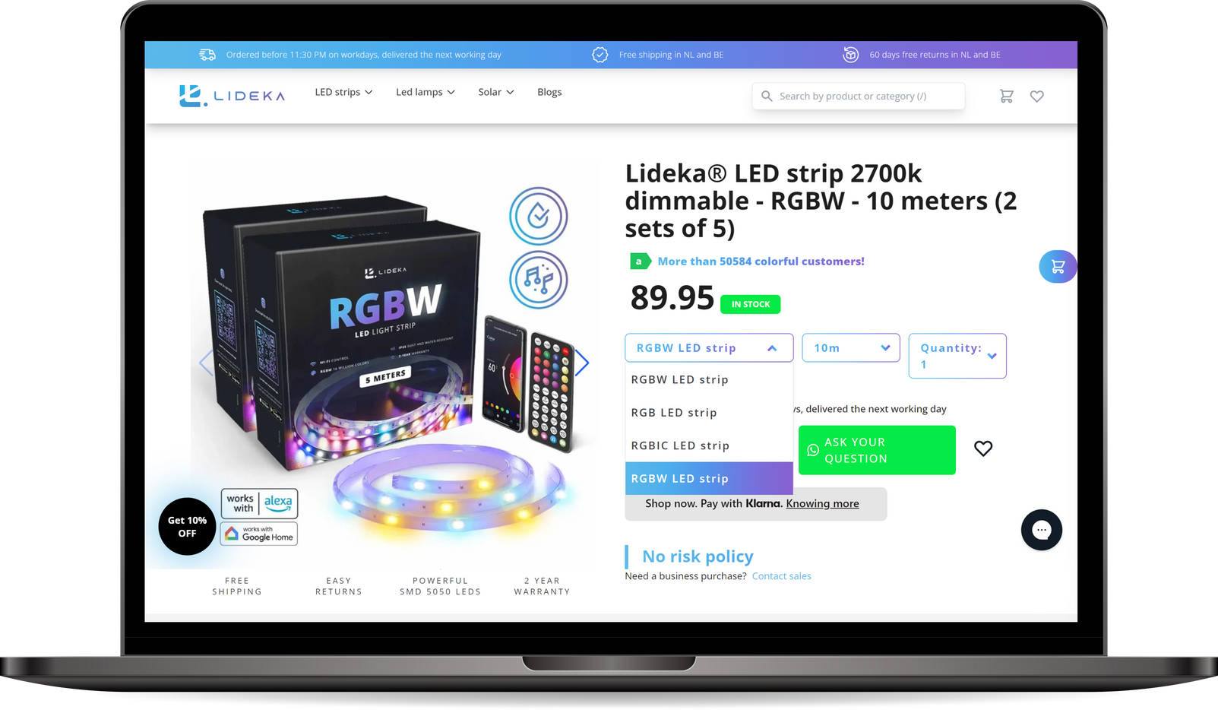

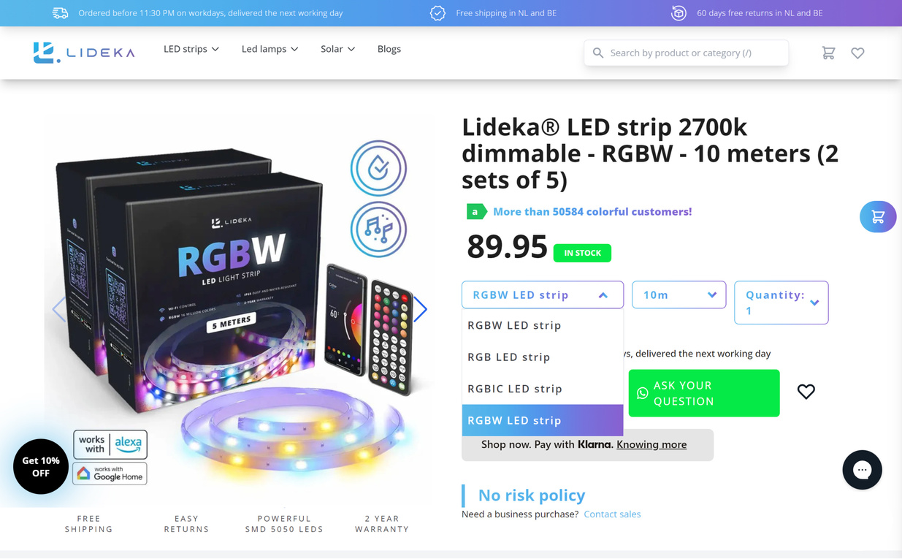
Headless CMS+
NuxtJS
Shopify
Google Tag Manager
Strapi
Lidkahome
iFlair played a crucial role in developing the Lideka Home eCommerce website, delivering a sophisticated and high-performance webshop tailored for home decor enthusiasts. Our team’s expertise in utilizing modern technologies and integrating various systems was pivotal in creating an exceptional online shopping experience. We utilized NuxtJS for frontend development, which allowed us to build a responsive and dynamic user interface that ensures a smooth and engaging browsing experience.
Shopify
Strapi CMS
Headless Framework
Key Highlights
  Headless CMS
  Integration with Shopify for Product feeds.
  Integrated Strapi for managing the Content
  Developed Custom booking engine & Cart Management.
  Klarna Payment integrations
Nuxtjs Framework
Reference: https://lidekahome.nl

Slide 24

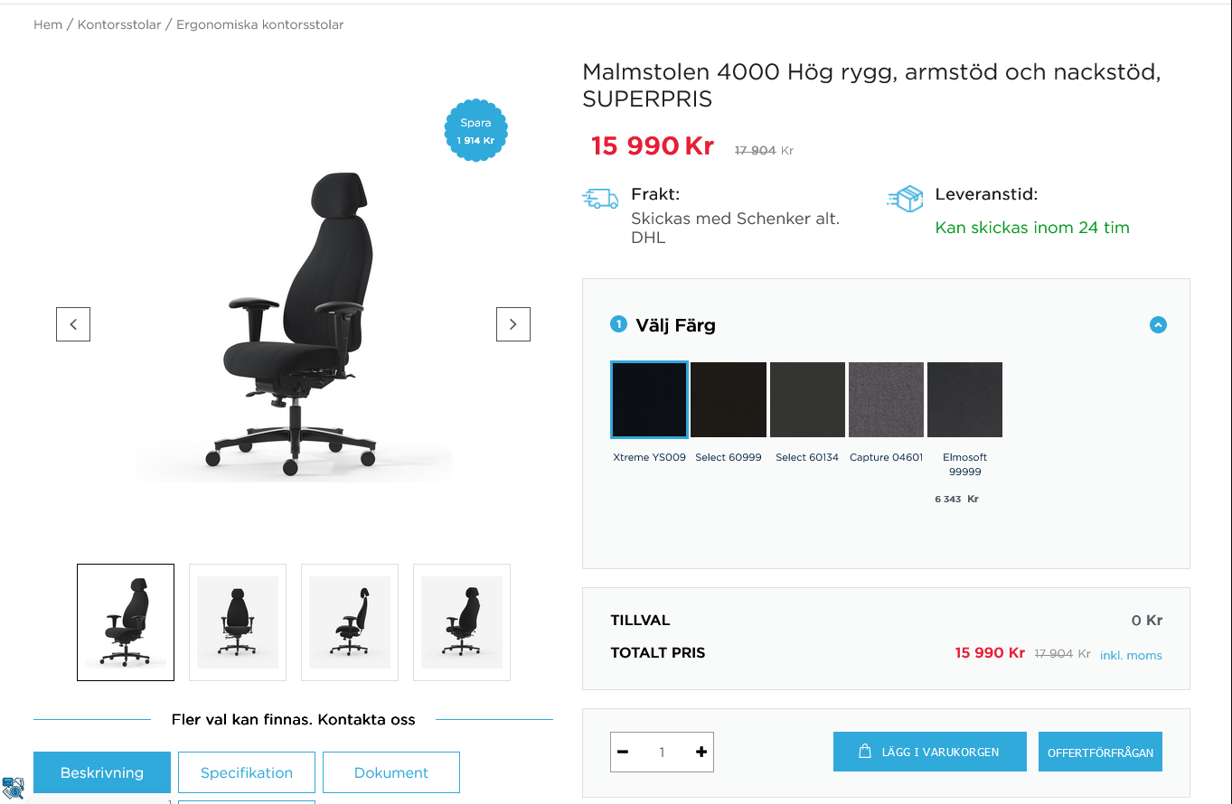
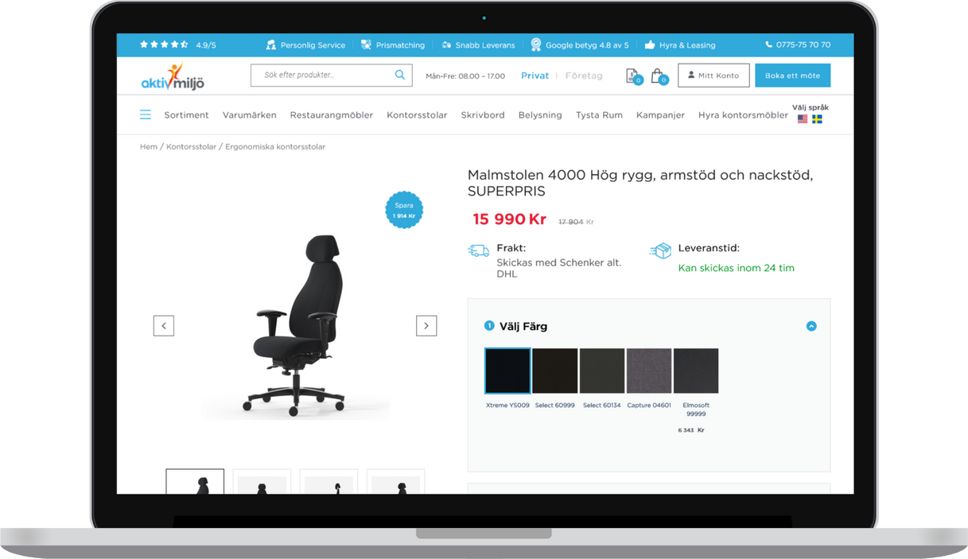
WooCommerce
Aktiv Miljö Enterprise
iFlair developed the Aktiv Miljö eCommerce webshop with a focus on delivering superior user experience. Our team designed a custom theme and developed six plugins to address specific business needs. Additionally, we integrated a secure payment gateway, optimized the site for search engine visibility, and ensured mobile responsiveness. This comprehensive approach resulted in a robust, user-friendly webshop that aligns with Aktiv Miljö’s business goals and commitment to sustainability.
Key Highlights
  10000+ Products Management
  100000+ Quotations Management
  200000+ Transactions, orders & Invoices
  User-Mode-Based Price Customization
  Outlook Calendar Integration
  Cross Platform Support
  WordPress blocks and components
Reference: www.aktivmiljo.se

Slide 25
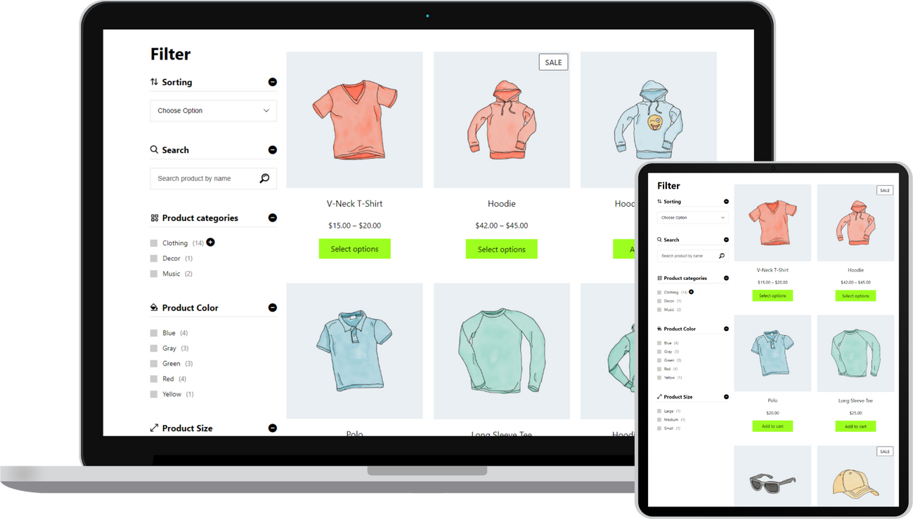
WooCommerce Product Filter
Plugin
WooCommerce
We have developed and published a WooCommerce Product Filters plugin that allows users to filter products by various criteria such as size, color, name, price, and categories. Fully compatible with WooCommerce, this plugin lets WordPress admins add custom filter criteria like brand and fabric. Its Ajax filtering feature enables sorting products without refreshing the page. The plugin is responsive across all devices and includes a left sidebar widget and a product filter count for a clear and straightforward shopping experience.
Key Highlights
  Dynamic Multi-Criteria Product Filtering
  Customizable Filter Criteria
  Intuitive Back-end Conﬁguration
  Sidebar Widget Integration
  Responsive Design
  Product Filter Counts
  Optimal Compatibility
Reference: https://wordpress.org/plugins/iﬂair-woo-product-ﬁlters/

Slide 26
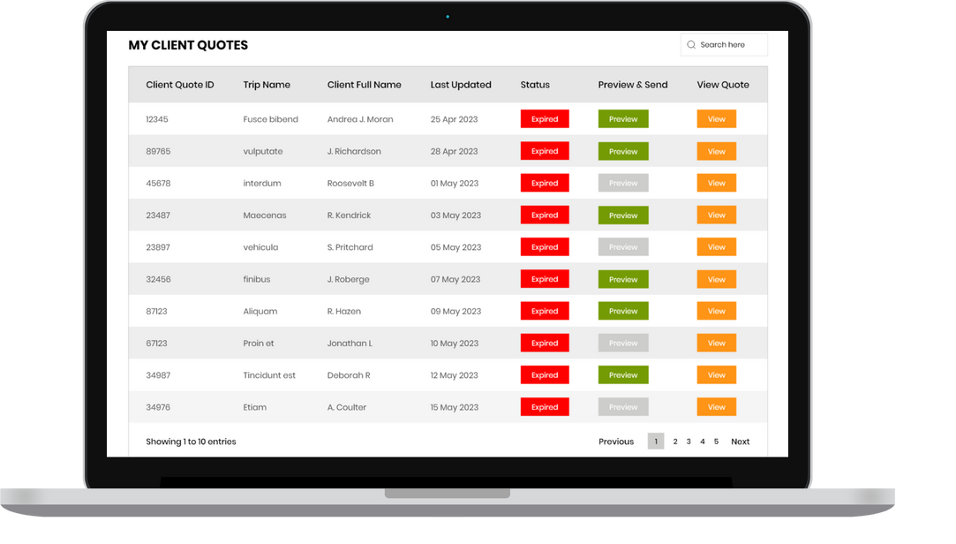
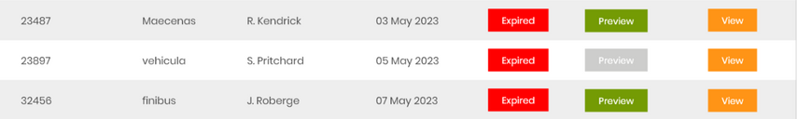
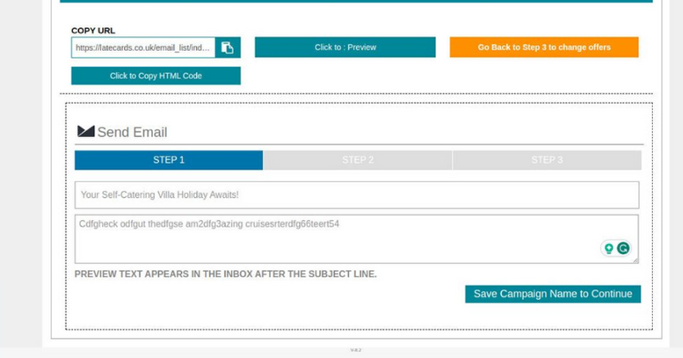
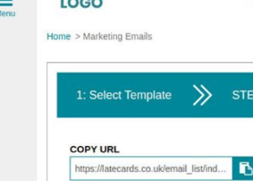
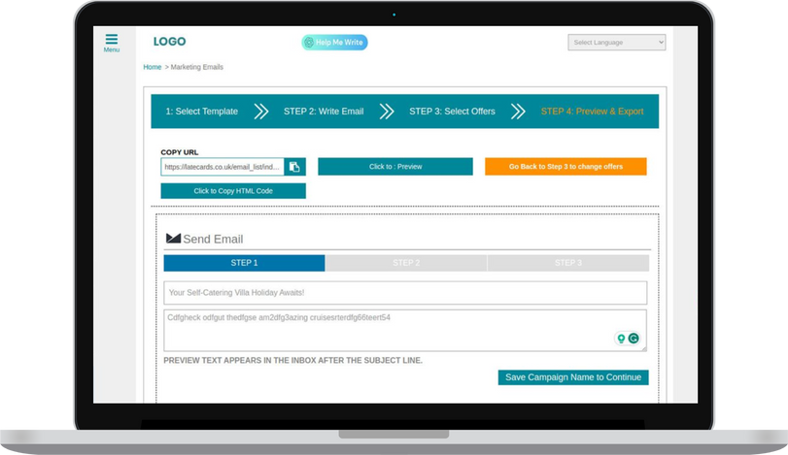
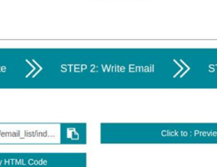
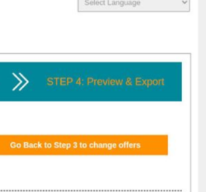
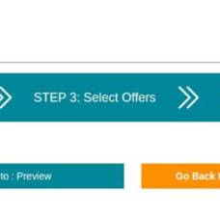
WordPress
SaaS
Laravel
Travel Marketing System
We developed a robust platform for Travel Marketing System, allowing easy enrollment for agents. The primary objective of the platform is to enable all the small tour operators technology ready. Using the solution Travel agents can create, manage & market their holiday packages for the travelers. The email marketing tool was customized so that the Tour operators gets the highest ROI. Additionally, we built a social planner tool that allows Tour Operators to manage all social media tasks at one place.
Key Highlights
  Developed 4 SaaS platform
    CRM, Social Planner, Email Marketing, Campaigns Manager
  170+ Travel Websites, 50K+ properties listed, 100K Cruise listed
  Intuitive Back-end Conﬁguration
  10000+ Inquireis Management
  350+ Agents Management
  250+ Custom Email Templates
  Integrated Multiple System like Xero, Quickbooks etc.
Reference: www.travelmarketingsystems.com

Slide 27
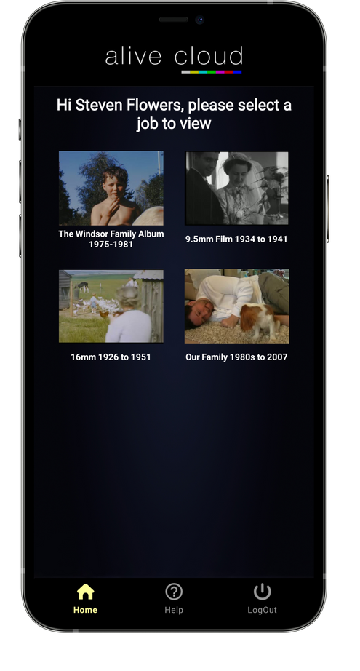
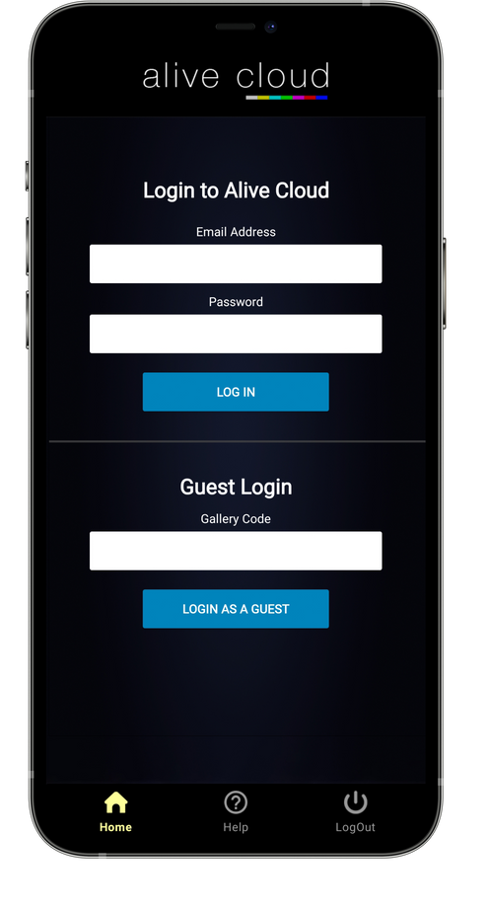
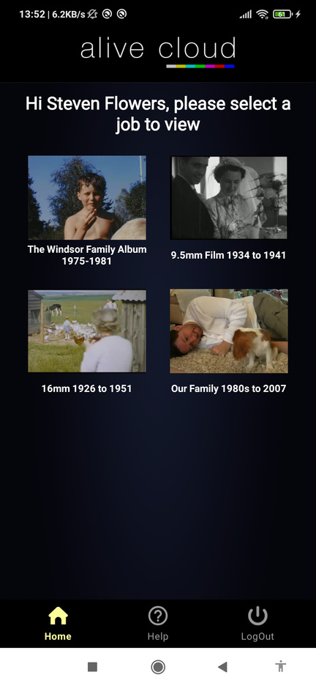
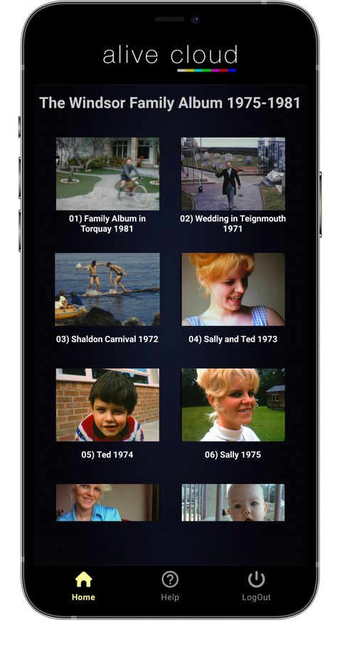
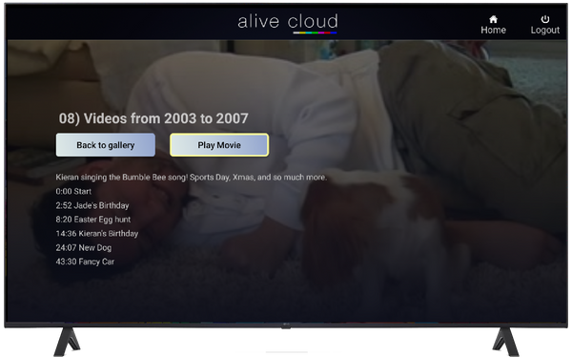
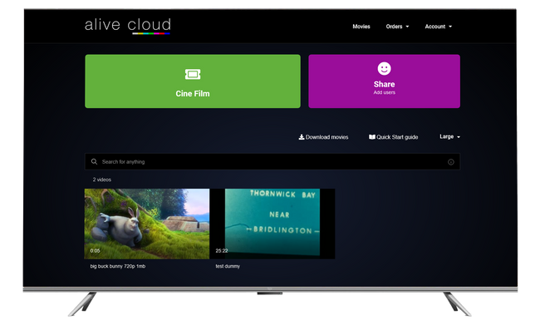
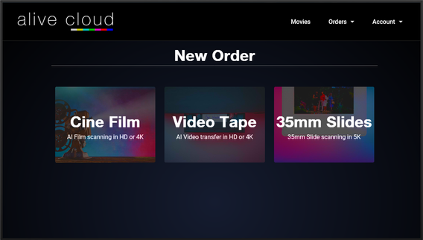
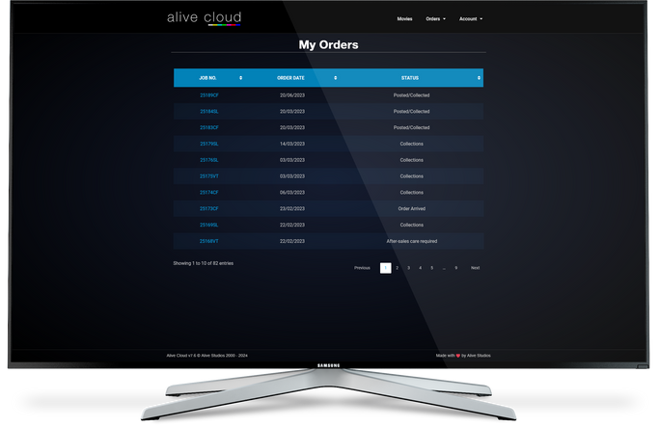
Android (Kotlin)
Swift (iOS)
AliveStudio
We developed a comprehensive video editing and playback platform for Alive Studios, enhancing the digitization and restoration of cine films and videotapes. Using Kotlin for Android and Swift for iOS, iFlair implemented a robust video player with comprehensive controls, muse.ai integration, and large video rendering capabilities. The platform features customizable REST APIs, Firebase, and Firebase Crashlytics for optimized performance and reliability. Additionally, iFlair ensured the platform includes user-centric features like auto-hide video titles, organized job access, customizable playback, and effortless video skipping.
Key Highlights
  Large Video Rendering
  Videos & Movie Player
  Digital Experience Platform
  User-Friendly Interface.
  iOS/Android TV App.
  Tizen OS TV App
  Web OS TV
  Web OS (LG Smart TV)
  Amazon Fire TV
  IOS TV application
Reference: https://www.alivestudios.co.uk/
  Android / IOS Mobile/Tablet Application
  Tizen OS (SamsungSmart TV)

Slide 28
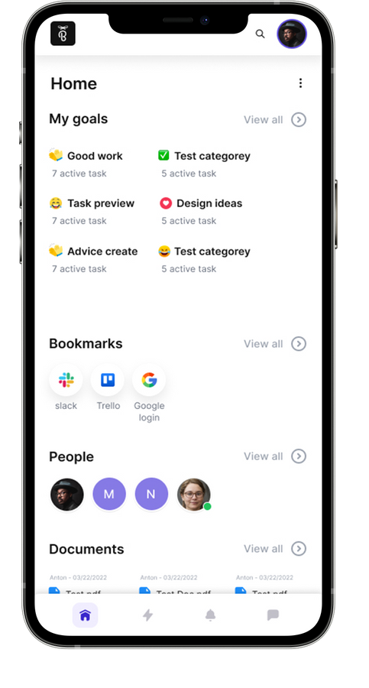
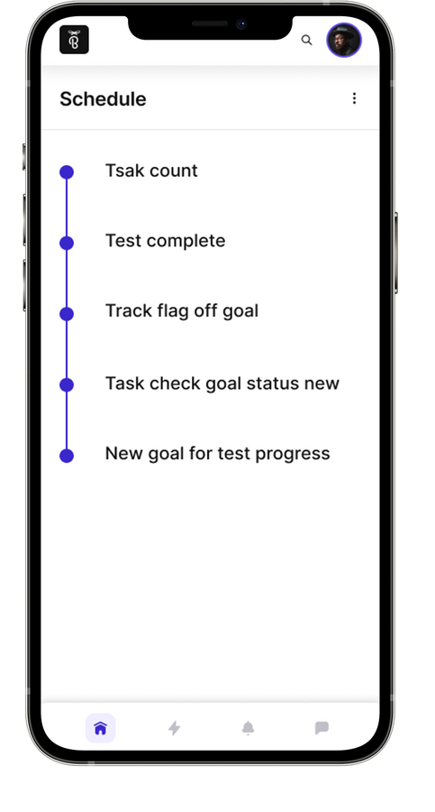
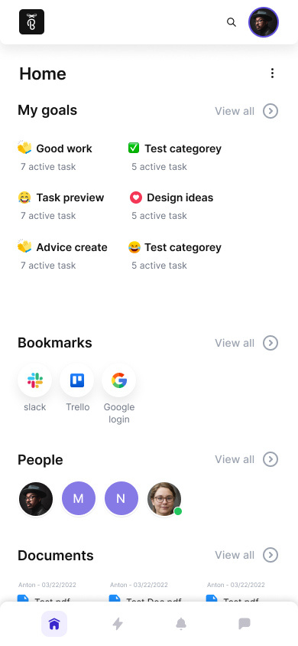
ReactNative (Expo Web)
TypeScript
TeamVate
iFlair played a key role in developing Team vate, ensuring it was both functional and user-friendly. They used React Native (Expo web + TypeScript) to build the platform, incorporating several important features. These included flexible workspace management, customizable one-to-one and group chat integrations, and draggable task-card management for better organization. iFlair also implemented thread functionality for organized discussions, custom emoji support in chats, and push notification integration for timely updates. Secure user authentication was enabled through email, Google, or Apple accounts, and personalized dashboards were created to display user-specific data.
Key Highlights
  Different workspace management.
  Customizable one-to-one and group chat integration.
  Custom emoji support.
  Topic-Specific Threads
Reference: https://www.teamvate.com

Slide 29
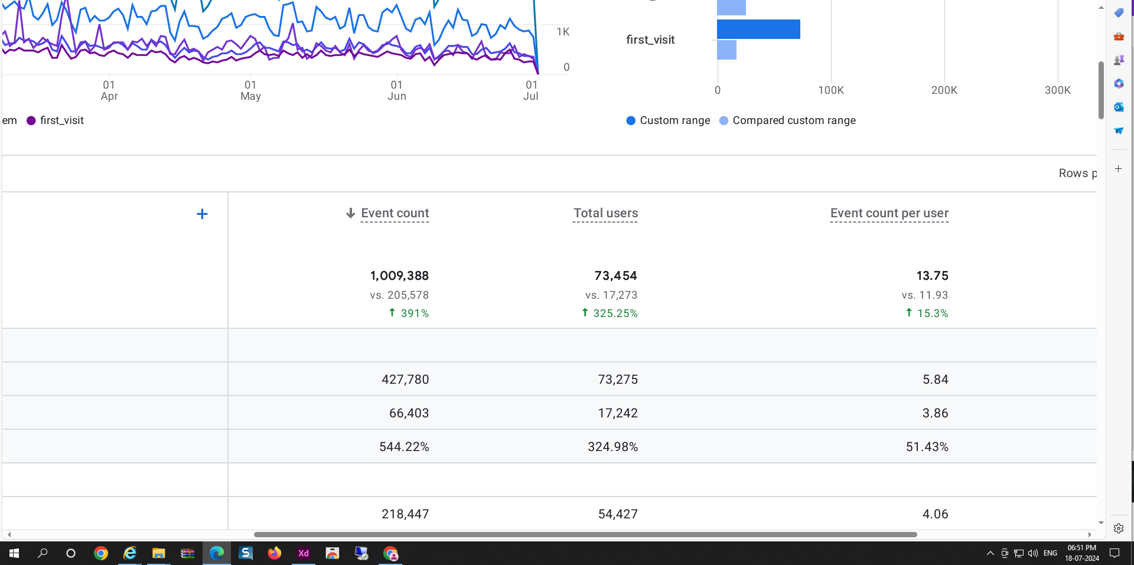
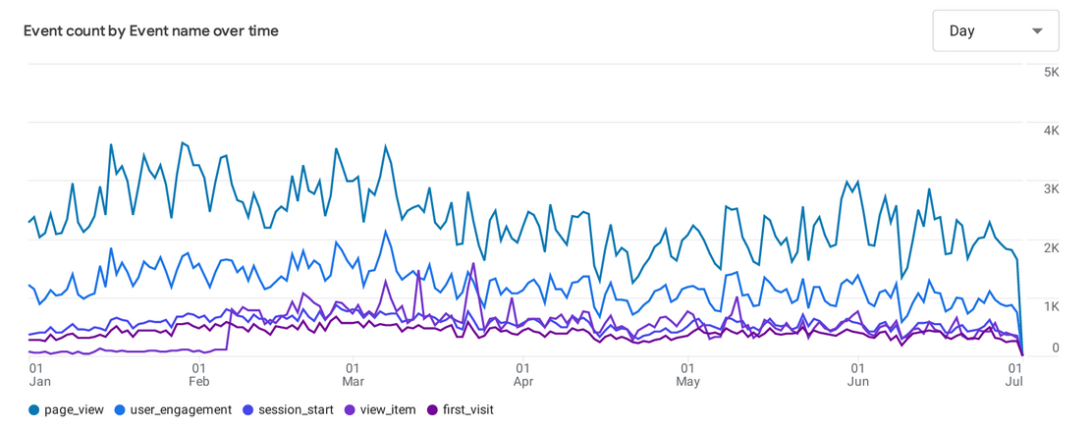

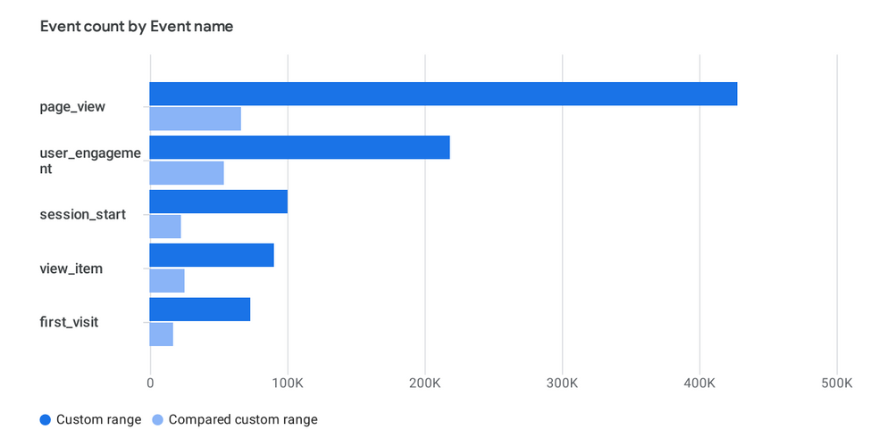
Magento
Conversion Rate Optimization
Nuform Cabinetry
iFlair significantly improved NuForm Cabinetry’s eCommerce platform by addressing low site traffic and order volume. We focused on enhancing user experience through practical changes, such as optimizing the checkout process and personalizing product recommendations. Improvements in site speed and mobile usability were made to reduce bounce rates, while key call-to-actions were added to guide user actions. Additionally, the UI/UX was redesigned to simplify navigation and enhance search functionality, resulting in better overall site performance and increased sales.
Key Highlights
  Conversion Rate Optimization:
    Personalized Recommendations: Added tailored product suggestions.
    Checkout Process: Simplified to make purchasing easier.
  Bounce Rate Reduction:
    Site Speed: Improved loading times and mobile usability.
  Call-to-Actions (CTAs):
    Addedfornewarrivals and bestsellers.
  Customer Journey Improvements:
    simplified navigation, and enhanced search functionality.
Reference: https://nuformcabinetry.com/

Slide 30

Magento 2.4.7
PHP 8.3
Hyvä
Distri Company
iFlair played a key role in Migrating Distri Company’s E-Commerce web shop, for better & secure webshop as well as extraordinary speed. The iFlair team created a user-friendly interface that supports various security products, such as intrusion detection systems, video surveillance, and access control equipment. They incorporated several important features, including a web shop for direct purchases, a support portal for technical help, and partner portals for managing SIM cards and processing RMAs. iFlair also focused on ensuring the platform’s scalability and reliability, implementing strong security measures and optimizing performance to meet diverse customer needs effectively. Our work has been crucial in providing a functional and efficient solution for Distri Company’s online operations.
Data
Migration
Version
Upgrade
Distri
Company
Hyva
Competible
Extension
Customization
Hyva
Integration
Key Highlights
  Used Tailwind CSS and Alpine.js for improved interface.
  Applied Hyva theme, increasing site speed by 50%.
  Built SAP API module for invoices and service calls.
  Developed Freshdesk API module for ticket data.
Reference: https://www.distri-company.com/

Slide 31
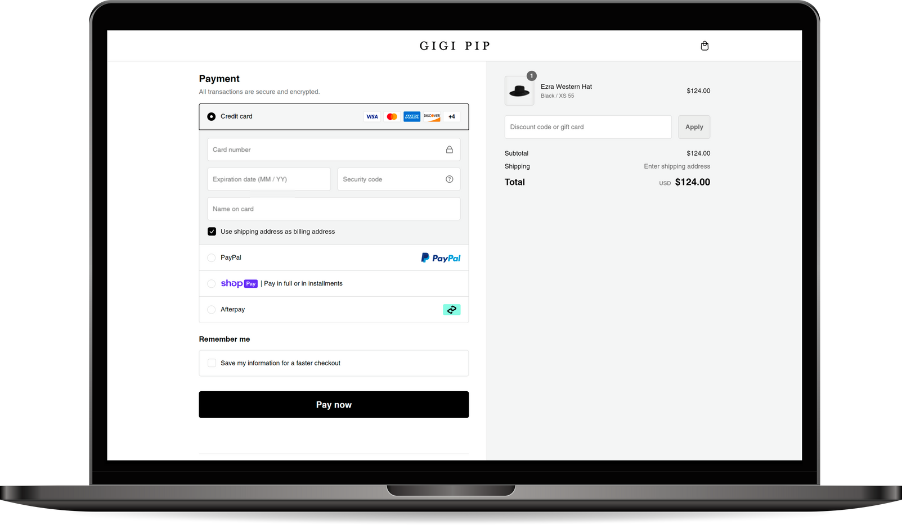
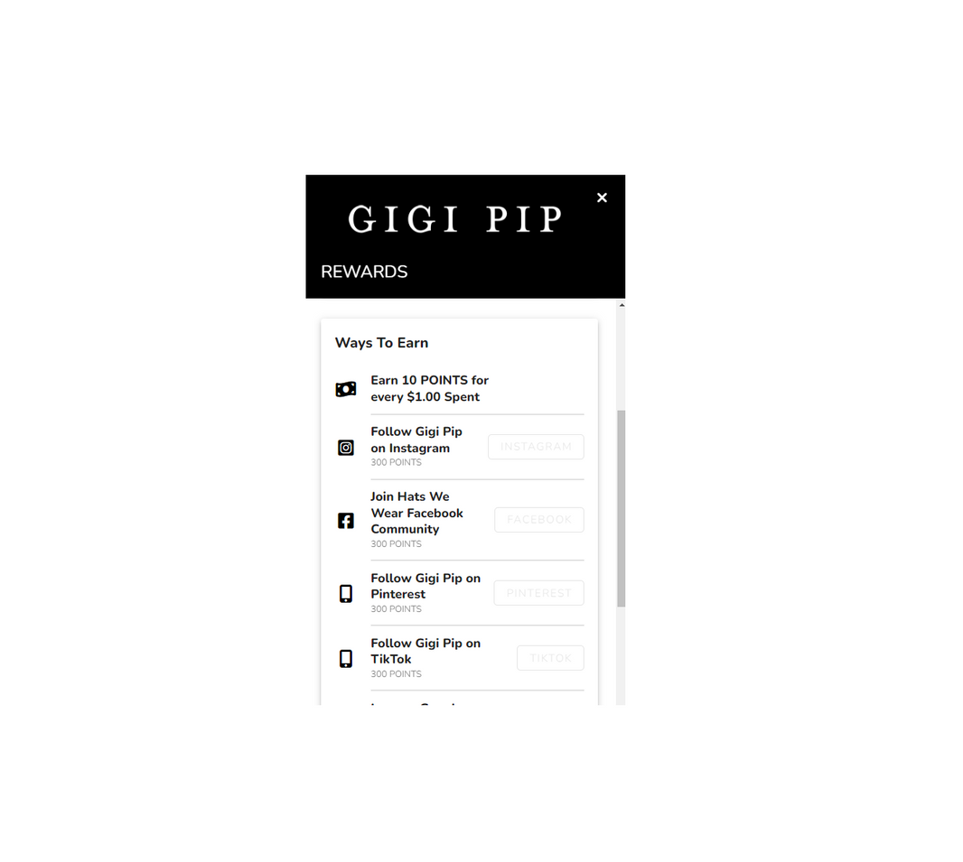
Shopify Plus
Earn cash
Gigi PIP
iFlair developed the Gigipip eCommerce site on Shopify. Our team customized the theme that matches with Gigipip’s brand identity and ensuring a responsive design. We added features like dynamic product catalog, intuitive navigation, and secure payment gateways. We optimized the site for speed and SEO, and set up analytics for tracking user behavior and sales. This comprehensive approach provided Gigipip with a user-friendly and efficient eCommerce platform.
Key Highlights
  Total Orders: 150,000+
  Total Products: 2,000+
  Earn cash: for users to earn money through Webshop
  Detailed Analytics Setup: For data driven decisions
  Custom Frontend Theme
  User-Centric Solution
  Speed Optimization
Reference: www.gigipip.com

Slide 32
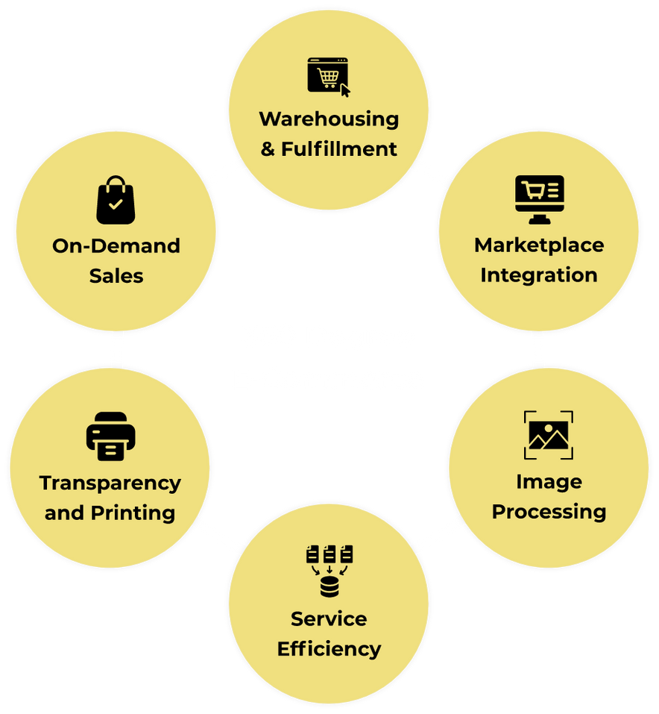
Print On Demand+
Wallet+
360 ﻿Degree
E-Commerce Fulfillment
Shipping+
Return Managment+
The 360 Degree eCommerce Fulfillment System is designed to streamline and enhance the entire e-commerce supply chain process, from product storage to delivery. This comprehensive solution ensures that businesses can focus on growth and customer satisfaction while the system efficiently manages warehousing, fulfillment, and sales integrations. By leveraging advanced technologies and marketplace connectivity, the system provides a seamless and branded experience for both sellers and customers, enabling businesses to expand their reach and maintain consistent quality and service standards.
Key Highlights
  Warehousing & Fulfillment:
    Manages e-commerce product storage and shipping.
    Provides branded service with logo customization.
  Marketplace Integration:
    Connects to major platforms like Amazon, eBay, Etsy, and Rakuten.
    Enables both national and international sales.
  Campaign AI - Google Vision Campaign Approval:
    Utilizes Google Vision API and DPM algorithm to verify brand image privacy.
    Streamlines the campaign approval process.
  On-Demand Sales:
    Offers automatic order forwarding links.
    Produces and ships goods under the client's brand upon customer order.

Slide 33
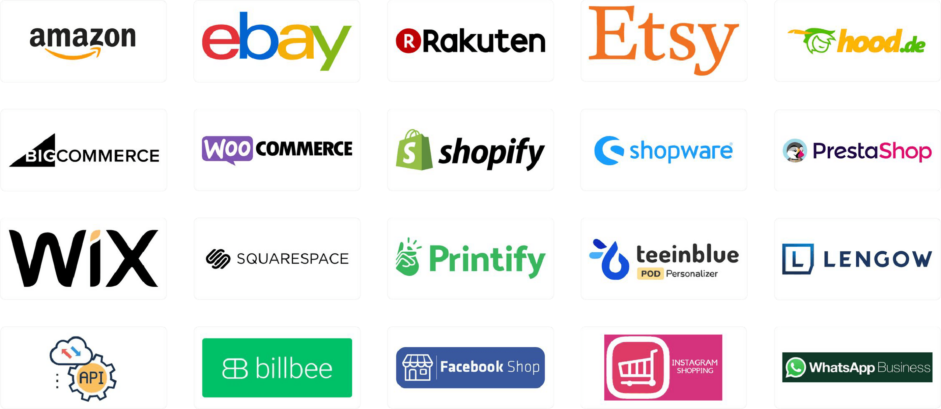
E-commerce Omni Channel - Sales Channels
Check out our integrations to find the perfect fit for your store. Elevate your drop shipping business by using our print-on-demand
service with our E-commerce omnichannel solution.

Slide 34



Security Assurance
As a secure and trustworthy
Company, we prioritize confidentiality.
Our commitment to your project's
success is backed by a signed NDA,
ensuring utmost privacy and safe-
guarding your valuable information.
Our agency prioritizes strict adherence to GDPR guidelines, ensuring robust data protection and privacy. Trust us to navigate the complexities, safeguarding your information with genuine compliance and expertise.
Rest assured knowing your data is
in secure hands. Our ISO 27001 certification underscores our dedication to top-tier information security, offering you confidence in our protective measures.
www.iFlair.com

Slide 35



Testimonials
Timo Lampola
Sonny Geerts
We at Helpten have now worked one year with iFlair. Mobile app development has went super good, and also support and communication has been very good. Special thanks to Priya!
It’s a great experience working together with Iflair. The quality of work that Iflair deliver is outstanding and exceeds my expectations. The employee's are friendly hard workers that truly listen to the wishes of the customer. It’s a first class recommendation.
Company
Abax Finland Oy (Helpten)
Company
Finland
GRS Retail BV
Technology
Netherlands
Native App
Technology
URL: https://www.iflair.com/portfolio_page/helpten/
https://www.abax.com/fi
Laravel, Tailwind CSS
URL:
https://www.grsretail.nl

Slide 36

Testimonials
Carlos Garreta
Julià Borruel
The client was happy with iFlair Web Technologies Pvt. Ltd.'s services. The team was agile and responsive, allowing them to deliver tasks on time. They had great communication and follow-up skills, resulting in a truly smooth collaboration. Overall, the project was a success.
iFlair Web Technologies Pvt. Ltd. completed the deliverables in a short period of time. They also had excellent communication sills; they constantly gave updates about their progress to the client. Moreover, their professionalism and kind approach stood out
Company
Company
Mind Your Gap Studio
Omitsis Consulting SL
Spain
Spain
Technology
Technology
Web Development
Custom Software Development, Web Development
URL:
URL:
https://clutch.co/profile/iflair-web-technologies#review-202538
https://mindyourgap.com/en/
https://clutch.co/profile/iflair-web-technologies#review-168783
https://www.omitsis.com/

Slide 37
Testimonials
Farid Houas
Frank Olivio
iFlair has an excellent customer service and has experienced knowledge in several technologies. They were always able to solve new challenges during the development stages. We also have a great dedicated project manager who understands our vision and transfer it fast and perfectly to its development team. Definitely happy to count iFlair with it's great team for our long-term partnership who always meets our expectations.
We have tried a number of website developers, but were not
successful until we hired iFlair. Our website is not a basic template
style site. It requires deep coding knowledge, which the iFlair team
has. They can tackle every task we have and do so in a timely
fashion. We are quite pleased with iFlair and the whole team.
Company
Company
Williams and Williams, Inc.
Kite Trotter AG
United States
Switzerland
Technology
Technology
WordPress & WooCommerce
Vuejs, Laravel, WooCommerce
URL:
URL:
https://www.iflair.com/portfolio_page/nametags4u/
https://nametags4u.com/
https://www.iflair.com/portfolio_page/kitetrotter/
https://www.kitetrotter.com/

Slide 38
Testimonials
Buddy Fichera
Sam Willson
I wanted to take the time to write a note of gratitude to you and your firm, iFlair. As you know, we have worked together on Radyx’s coaching platform for over four years now, and I am 100% satisfied with the services you and your firm have provided us. Even though you are in India, and I am in America, your actions have strengthened trust… in that I know you will be there for me and our firm’s needs going forward.
We hired the iFlair team to develop a complex site design, to be developed entirely from scratch. All of the code was bespoke and there were a number of complex requirements, including complex SEO considerations, integrations, loading time criteria, different content to be displayed on different devices, and more. The design also changed a little throughout the project in response to their feedback...... more.
Company
Company
Radyx LLC
Virtalent Ltd,
United States
United Kigdom
Technology
Technology
Vue.js & Laravel
React, Laravel
URL:
URL:
https://www.iflair.com/portfolio_page/wheelhouse/
https://radyx.com/
https://www.iflair.com/portfolio_page/taskportal/
https://radyx.com/

Slide 39

Testimonials
Timothy Chiu
Steve Rushton
Want to give my appreciation to team at iFlair who are helping me. They help me prepare a mobile service platform that I will be using to help the small size food serving businesses. iFlair has develop the tools that help me thrive and survive this intensive competition. Long story short, they are a group of dedicated and reliable engineers who help you through the development process details by details, So if you need someone to make you a mobile app or website, I highly recommend them.
We have been working with iFlair almost six years. We were looking to outsource our project to someone who can grow up with us and maintain a healthy business relation throughout the long term, and yes we got the iFlair for our ambitious project: TMS. They are incredibly hard working and yes, they did a Skype call every day for a single update. That exactly we want from a company who can work very closely to meet our requirements. Their positive attitude for a single task would give me more enthusiasm towards my project.
Company
Company
Youphrates
Travel Marketing System Ltd.
United States
United Kingdom
Technology
Technology
Saas, Laravel, WordPress
Native App
URL:
URL:
https://www.iflair.com/portfolio_page/net-effect/
https://www.travelmarketingsystems.com/
https://www.iflair.com/portfolio_page/youphrates/

Slide 40
Testimonials
Paul Duan
Paul Giorgio
The client and their customers are consistently satisfied with iFlair's results-driven deliverables. The team strictly adheres to the project's timelines, and internal stakeholders are particularly impressed with the vendor's development efficiency and project management skills.
Best IT partner I have ever worked with! Excellent response time, customer service and tech know-how!
Company
Nuformcabinetry
United States
Company
Technology
The Hive Ltd
Magento & CRO
Malta
URL:
Technology
https://www.iflair.com/portfolio_page/nuform/
https://nuformcabinetry.com/
WordPress
URL:
https://www.hive.com.mt/

Slide 41
Testimonials
Vlad Tudorie
Rodrigo Costa
Within three months, iFlair Web Technologies Pvt. Ltd. has delivered the necessary UI designs and UX flows. In addition, they've also made significant progress on the app's front- and backend. Moreover, the client has gained extensive insight into the product value and market impact.
We have tried a number of website developers, but were not
successful until we hired iFlair. Our website is not a basic template
style site. It requires deep coding knowledge, which the iFlair team
has. They can tackle every task we have and do so in a timely
fashion. We are quite pleased with iFlair and the whole team.
Company
Company
FusePress Inc.
My Digital Bizz
Romania
Belgium
Technology
Technology
Next.js & Laravel
UX/UI Design, Web Development
URL:
URL:
https://clutch.co/profile/iflair-web-technologies#review-172188
https://fusepress.co/
https://clutch.co/profile/iflair-web-technologies#review-270360
https://mydbizz.com/

Slide 42
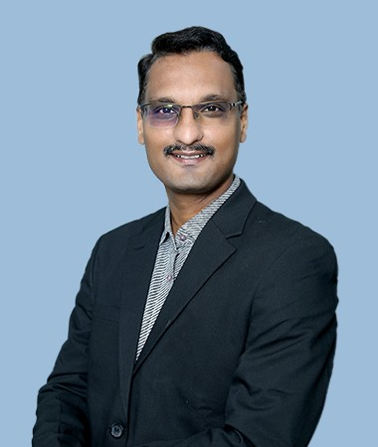
Our Leaders
Jinal Shah
Founder & Managing Director
Jinal Shah is a visionary IT leader with exceptional leadership and entrepreneural spirit. With 25+ years of success in the IT field globally and equivalent experience in Information technology in creating, growing & stabilizing new lines of business in industry verticals as well as in enterprise applications & transformation services.
His areas of specialization include sales, marketing, business process outsourcing, IT transformation, IT strategy formulation, and enterprise applications implementations and creation of global positioning strategies
for IT service offerings. He provides solutions to the clients needs, better than others, which helps them with their problems more effectively.

Slide 43
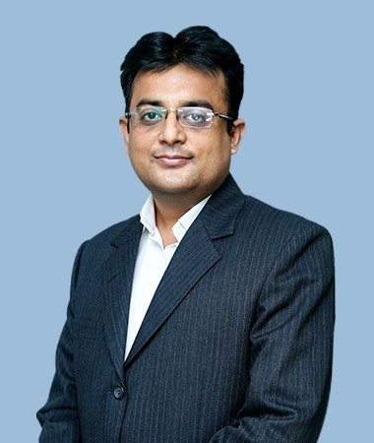
Our Leaders
Viral Doshi
Chief Executive Officer
Viral Doshi is a Result oriented IT Management Person, 25+ yrs of experience, with a proven track record for successfully implementing large complex applications to support growth on business value. Dynamic person, who has demonstrated the ability to gain credibility and trust at all levels of an organization.
A decisive, loyal & focused person who leads high-performing team of 250+ across multiple facets of the digital solutions team including Design, Development, QA & Deployment for Web, Mobile, eCommerce & SaaS for Off-shore as well as Local clients Additionally, leading Human Resource & Accounts Department.

Slide 44
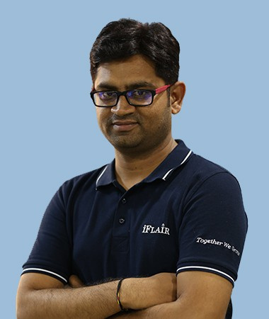
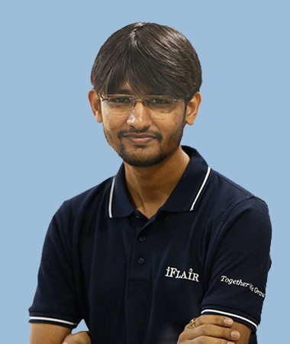
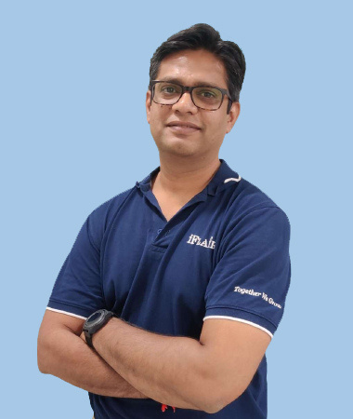
Our Leaders
Gaurang Jadhav
Hemang Shah
Vicky
Vice President (E-commerce)
Assistant Vice President (Web)
Assistant Vice President (Sales)

Slide 45



Our Leaders
Kinjal Patel
Lopamudra Das
Jignesh Jadhav
Sr Project Manager (E-commerce)
Sr Project Manager (Digital Solutions)
Project Manger (Digital Solutions)

Slide 46
Get in touch with us
At iFlair, we believe in building lasting partnerships founded on trust, expertise, and a shared commitment to excellence. Our dedicated team is passionate about helping you achieve your goals and driving your business forward with innovative, customized solutions. Let's work together to create impactful results that set you apart in the market. We look forward to the opportunity to collaborate and contribute to your success.
US: +1-347-878-2931
DK: +45 36 98 05 05
info@iflair.com
www.i﻿Flair.com

